Slide 1
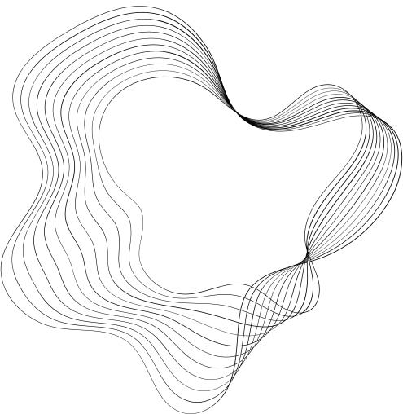
BIO MEDICAL IMAGE ANALYSIS
07 February 2025
Akula Akhil Vignesh CB.SC.U4AIE23303
Prisha Gupta CB.SC.U4AIE23331
Vedant Maheshwari CB.SC.U4AIE23346
Naksh Singh CB.SC.U4AIE23361

Slide 2
/02
Motivation
Early detection of brain tumors is critical for improving patient survival rates.
Manual MRI analysis is time-consuming and prone to human error.
AI-driven methods can enhance diagnostic accuracy and efficiency.
Potential to contribute to medical imaging advancements and bioinformatics research.

Slide 3
/03
Significance
Provides a non-invasive, automated tool for detecting brain tumors.
Reduces dependency on manual MRI interpretation, assisting radiologists.
Enhances diagnostic speed and accuracy, leading to better treatment decisions.
Bridges the gap between AI, bioinformatics, and medical applications.

Slide 4
Literature Review
/04
 | TITLE | AUTHOR &YEAR | OUTCOME | LIMITATIONS
1 | Automated brain tumour detection and segmentation using superpixel-based extremely randomized trees in FLAIR MRI | Soltaninejad, Lambrou,et.al; 2022 | Brain tumor segmentation method - superpixel based approach; Preprocessed MRI images,and then converted 3D imgs to 2D | Real time segmentation in a large scale is very computationally expensive as SVM KNN and decision trees were used(ensemble methods) BRATS 2017 model is not fully verified datasert
2 | Effective Algorithm For Benign Brain Tumor Detection Using Fractional Calculus | Saroj K,Manish K et.al;2018 | Fractional order mask result from a fractional calculus derivation makes the base of new algorithm to detect benign tumour at low computional cost | Although fractional calculus improves noise resistance, extreme noise conditions may still impact accuracy

Slide 5
Literature Review
/05
 | TITLE | JOURNAL & YEAR | OUTCOME | LIMITATIONS
3 | Performance optimisation of deep learning models using majority voting algorithm for brain tumour classification | Gopa.s, Ashish T., et.al;2021 | SVM and KNN used handcrafted features like texture and intensity CNNs such as VGG16, ResNet, and GoogleNet extracted features automatically, improving accuracy Majority Voting combined multiple DL models - optimize tumor classification ,Models trained on MRI datasets by a Five-Fold cross-validation | Manual intervention was found while selecting texture and intensity qualities While CNN was extracting the data from VGG116 and ResNet and GoogleNet, dataset inconsistencies were found,resulting in giving less quality info despite the accuracy found
4 | Brain tumor classification from MRI images using exponential-Walruses hunting optimization driven SqueezeNet | Pendela K, Ramesh K, et.al;2021 | Optimisation techniques integrated into SqueezeNet. Improved accuracyy and precision comapared to CNN models | The integration of multiple optimization techniques increases the model's complexity, which may lead to overfitting

Slide 6
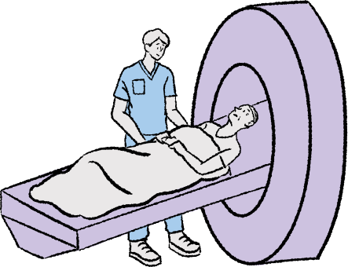
/06
Objectives
Develop a deep learning-based system for detecting brain tumors from MRI scans using Convolutional Neural Networks (CNN).
Classify tumors based on learned features.
Localize the tumor region within the MRI scan.

Slide 7
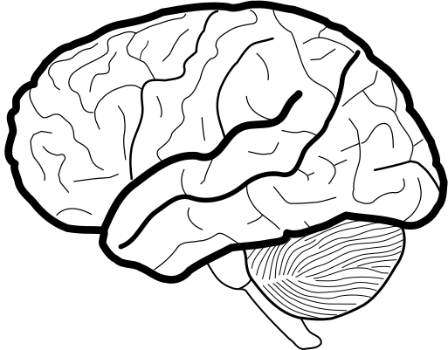
/07
Expected Outcome
A trained CNN model capable of accurately detecting and classifying brain tumors.
Visual representation of the tumor location within the MRI scan.
An AI-powered system that assists radiologists in faster and more reliable diagnosis.

Slide 8
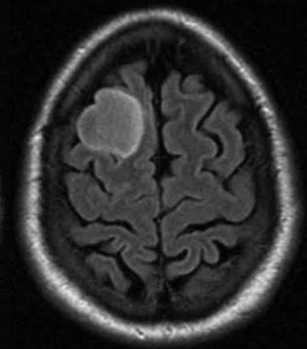
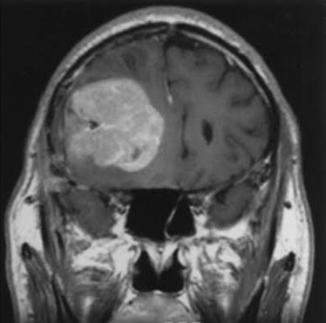
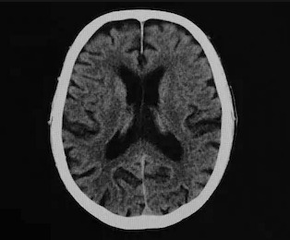
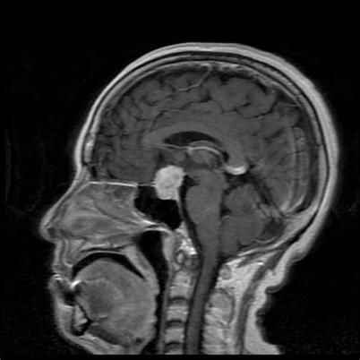
/08
Dataset
The Brain Tumor dataset is collected from IEEE Dataport (https://ieee-dataport.org/documents/brain-tumor-mri-dataset#files). This dataset is a combination of the following three datasets :
figshare
SARTAJ dataset
Br35H
This dataset contains 7023 human brain MRI images classified into 4 classes: glioma - meningioma - no tumor and pituitary.
no tumor class images were taken from the Br35H dataset.

Slide 9
/09
Methodology
Data Collection & Preprocessing
MRI scans are collected and preprocessed by converting them to grayscale, normalizing pixel values, and resizing for consistency.
Model Architecture
A Convolutional Neural Network (CNN) is used to analyze MRI images and extract key features for classification and localization.

Slide 10
/10
Methodology
Localization
The model helps in identifying the region of interest in the MRI scan where the tumor is located.
Evaluation & Refinement
Performance is assessed using accuracy metrics, and optimization techniques are applied to improve results.

Slide 11
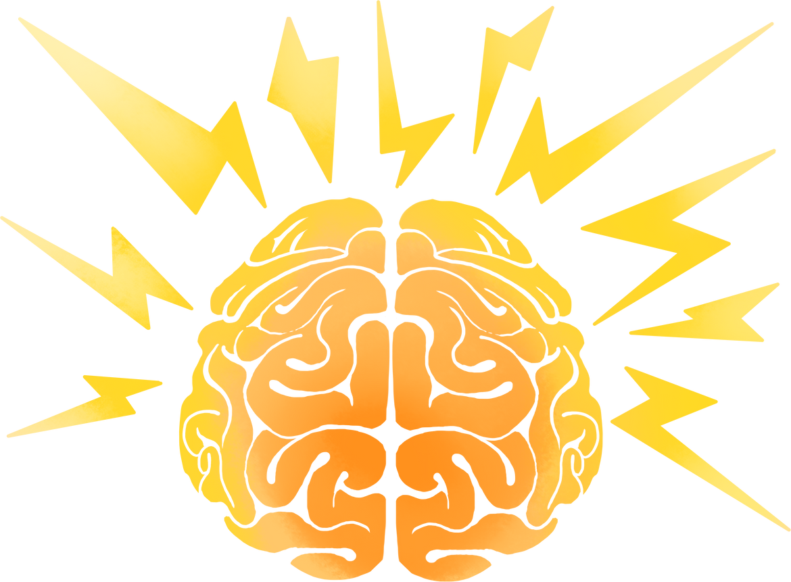
/11
Methodology
Time Complexity Analysis
In DAA, analyzing the efficiency of algorithms is crucial.
The CNN model has different layers with computational complexities:
Convolutional Layer: O(n2k2) (where n is input size, k is kernel size)
Fully Connected Layer: O(nm) (where n and m are neurons in consecutive layers)
This complexity analysis helps us optimize the model for faster execution

Slide 12
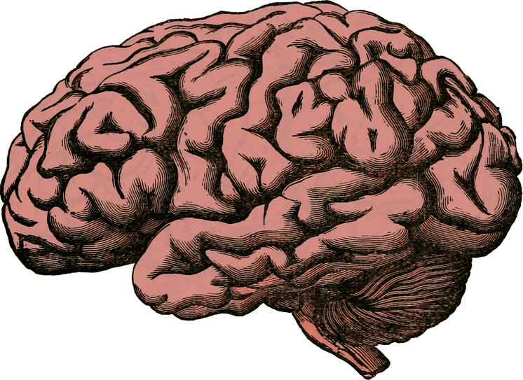
/12
Methodology
Optimization Techniques
Gradient Descent and Backpropagation are optimization algorithms used to train the CNN model efficiently.
Techniques like dropout and batch normalization are used to enhance generalization and prevent overfitting, which is similar to optimizing traditional algorithms in DAA.

Slide 13
/13
References
1) Soltaninejad, M., Yang, G., Lambrou, T. et al. Automated brain tumour detection and segmentation using superpixel-based extremely randomized trees in FLAIR MRI. Int J CARS 12, 183–203 (2017) [1]
2)S. K. Chandra and M. Kumar Bajpai, "EFFECTIVE ALGORITHM FOR BENIGN BRAIN TUMOR DETECTION USING FRACTIONAL CALCULUS," TENCON 2018 - 2018 IEEE Region 10 Conference, Jeju, Korea (South), 2018, pp. 2408-2413, doi: 10.1109/TENCON.2018.8650163. [2]
3)Gopal S. Tandel, Ashish Tiwari, O.G. Kakde,Performance optimisation of deep learning models using majority voting algorithm for brain tumour classification,Computers in Biology and Medicine,Volume 135,2021,104564,ISSN 0010-4825, [3]
4)Pendela Kanchanamala, Ramesh Karnati, Ravi Kumar Tammineni,
Brain tumor classification from MRI images using exponential-Walruses hunting optimization driven SqueezeNet,
Expert Systems with Applications,Volume 271,2025,126633,ISSN 0957-4174 [4]

Slide 14


/14

